Slide 1


Twitter/X Clone
http://fsd08-twitterclone.azurewebsites.net/
Meredith White | Shiyuan Xu | Xiaoxing Pan

Slide 2
AGENDA
Introduction
User Features
Technology
Database
Challenges & Solutions
Future Work
Summary

Slide 3
INTRODUCTION
Application Y attempts to clone the core features of the social media platform X, formerly known as Twitter.
X is a microblogging platform where users publish short posts, and interact with other users and posts via likes, follows, comments, retweets, and messages.
X has many advanced features for searches, trends, suggestions, and moderation.

Slide 4
User features
Non-admin user
Register, login, logout
Post, edit, delete a tweet
View, retweet with or without added content, reply, like
Follow/unfollow users
Search for tweets and users
View user profiles
Edit profile, upload avatar, reset password
Send and receive messages
Report tweets to admin
Admin
View reports
Suspend tweets

Slide 5
Technologies
ASP.NET Core (Razor Pages)
SQL Server
Entity Framework Core
View components, Partial Views
ASP.NET Core Identity
Azure Blob Storage & hosting
Web API
AJAX
JQuery
Bootstrap
Rich text editor: CKEditor

Slide 6
Approach
Xiaoxing
Shiyuan
Meredith
Search
Notifications
Follows
Trends
Views & components
Database & models
Tweets, retweets, replies
Likes & follows
Admin operations
Reset password
Login & registration
User settings
Messages
Image uploads
Azure hosting

Slide 7
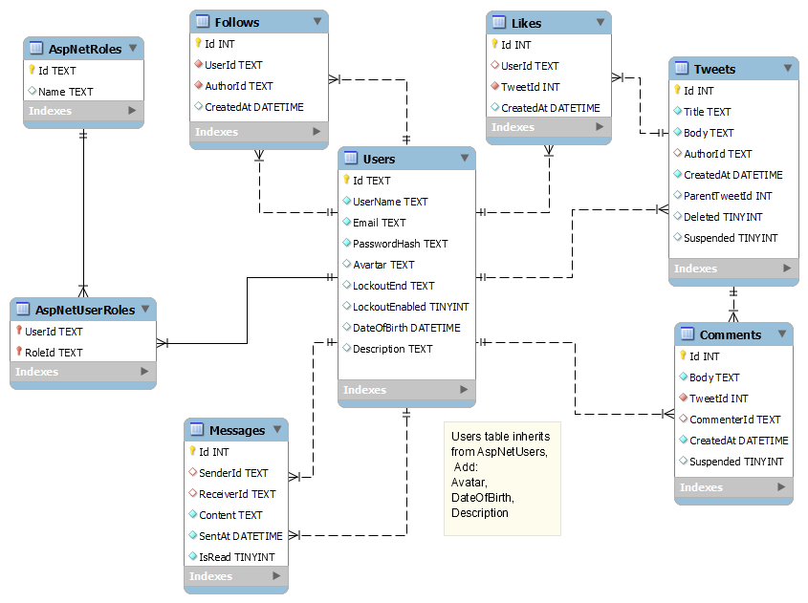
Database

Slide 8
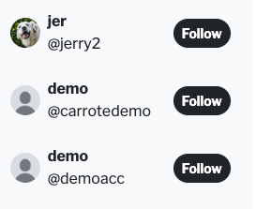
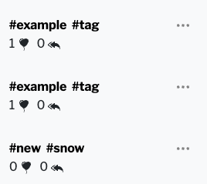

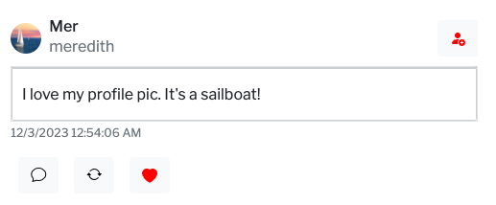
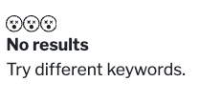
Break down to small pieces & make it reusable
Challenges & solutions
Right sidebar
Search Result
Follow Suggestion
Right sidebar
Search Result
Show more Trend
Right sidebar
Show more Trend
Partial View
Search user/tweet
Search Trend
!Anywhere a tweet is displayed

Slide 9
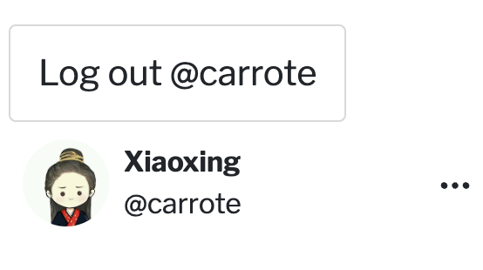
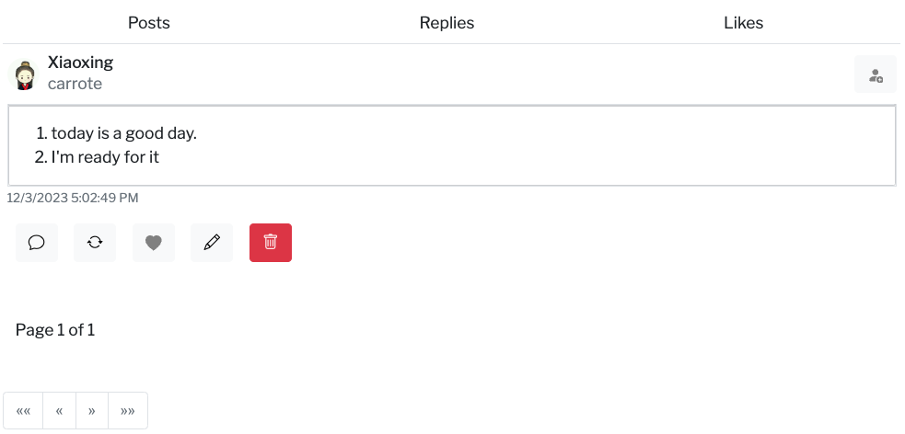
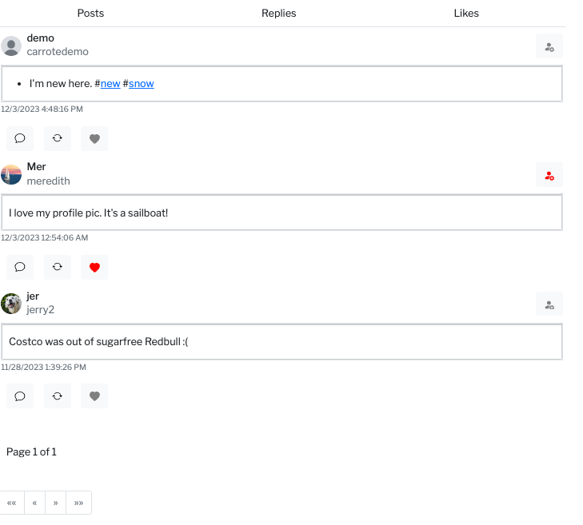
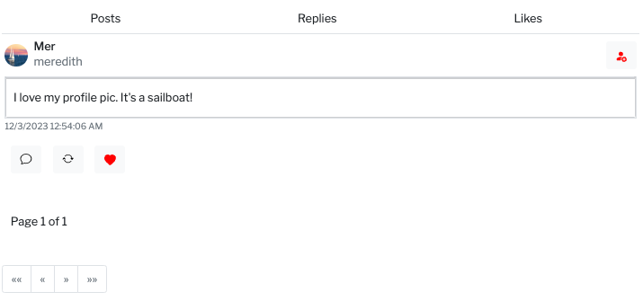
Challenges & solutions
Break down to small pieces & make it reusable
Left navbar/_layout
Edit profile
View Component

Slide 10

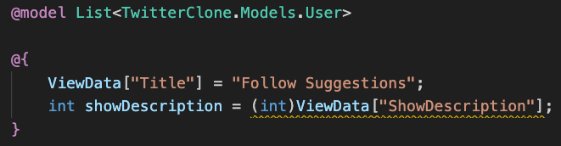

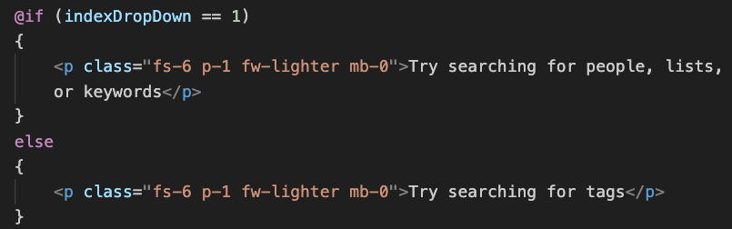
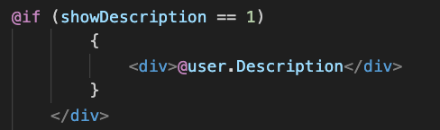
Challenges & solutions
Partial view control
Parent Page
Partial View

Slide 11
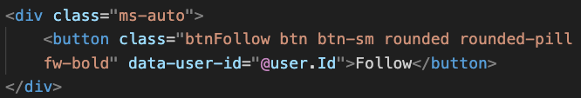
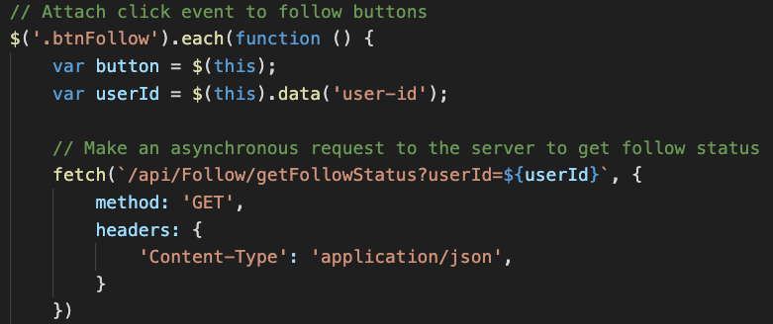
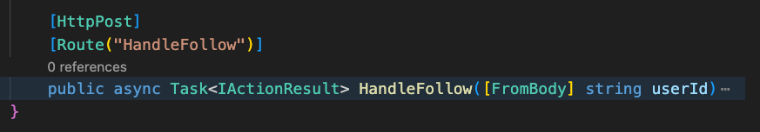
Challenges & solutions
Partial view control
Button
JavaScript
Controller

Slide 12
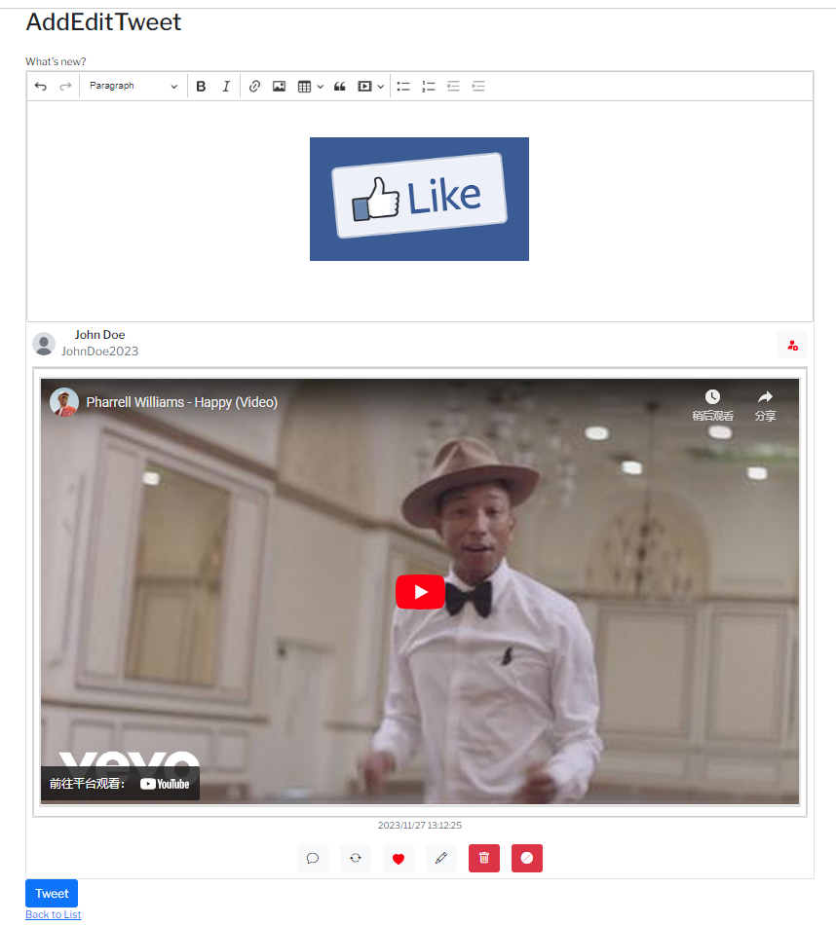
Solution: CKEditor
One of the most popular Richtext editor
Text format, Images, Links, Tables...
Customized interface
Cloud platform & EasyImage
Edit mode & readonly mode

Slide 13
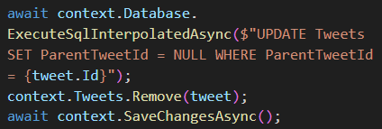
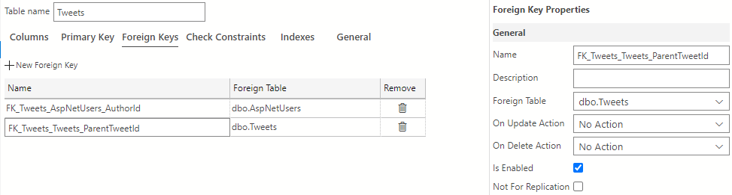
Solution: Cascading in sql server
A table cannot apear more than once in a cascading tree

Slide 14
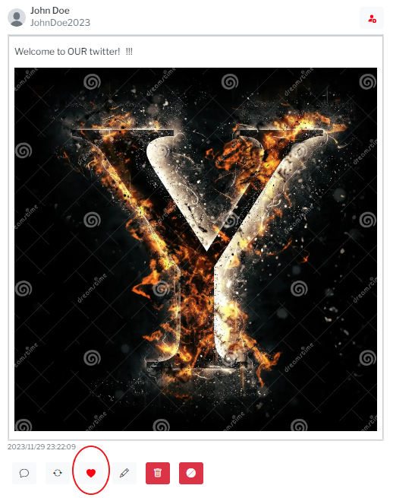
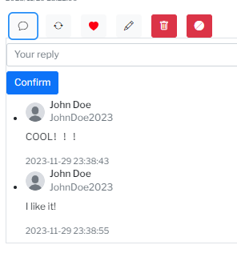
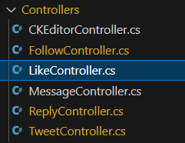
Using mvc in Razor page
Razor pages
Asp.net MVC
organizing the application by feature
URL structure directly related to the physical location and filename of the page.
Suitable for small to medium-sized applications
MVC architecture
Requires configuring routing rules
Suitable for large, complex applications

Slide 15
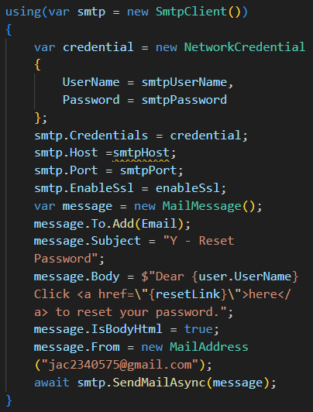
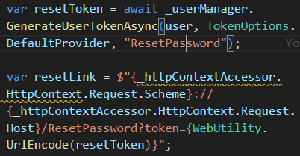
Solution： reset password by email
SMTP service
Token
Url Safe

Slide 16
Challenge:
Combining server-side rendering with client-side features

Slide 17
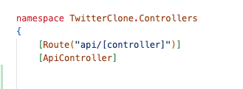
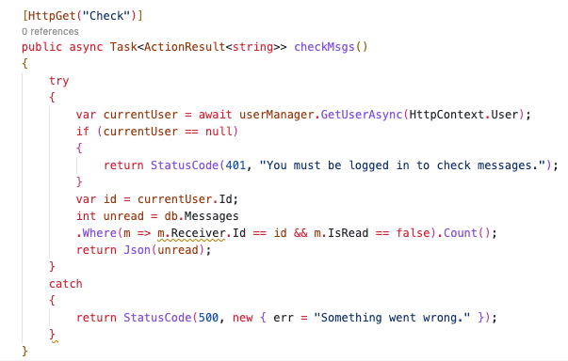
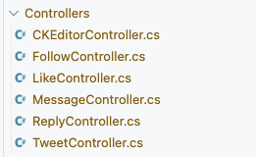
Solution: ASP.NET Web API

Slide 18
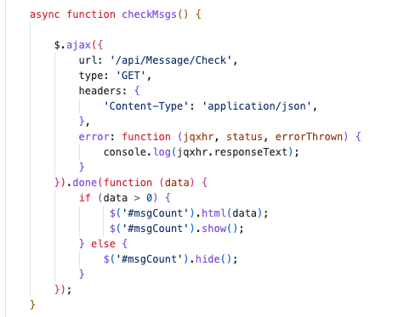


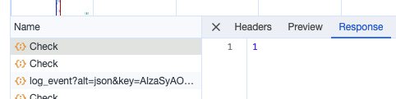
SOLUTION: ASP.NET WEB API

Slide 19
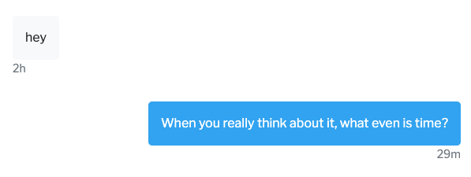
Challenge: Accurate DateTimes across different timezones

Slide 20
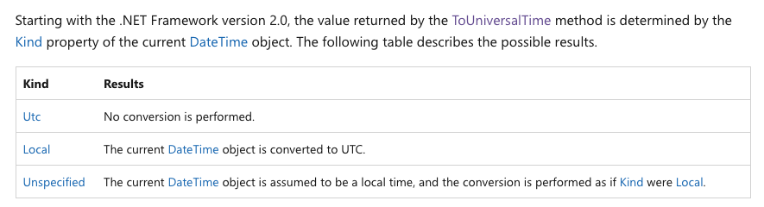
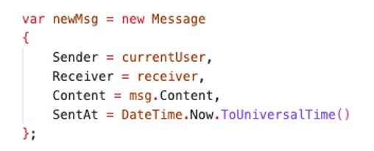
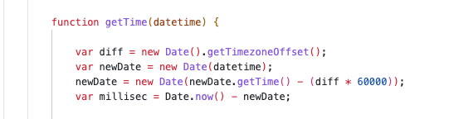



SOLUTION: RTFM (or Ratfm)

Slide 21
Future work
1
Suspend Tweet/User list, suspend user
2
Notification
3
Threads
4
Expanded user settings

Slide 22
summary
We achieved a likeness to the real X with ASP.NET Core
User accounts replicate most of the core features
There are many microblogging features to interact with:
Post a tweet in rich text
Reply, like, retweet others’ tweets
Report tweets to admin
Follow and unfollow other users, view other user’s profiles
Send and receive messages
Suggestions, trends, advanced search
Functional admin controls to suspend/unsuspend tweet.

Slide 23
THANK YOU

